Slide 1
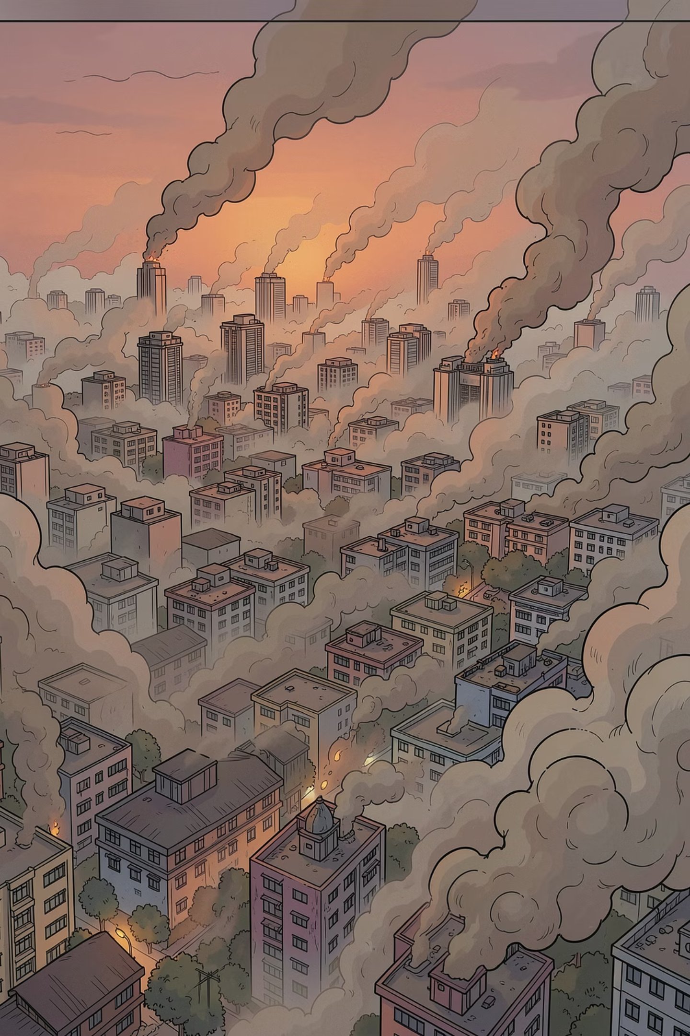
India Air Quality Crisis: 2010–2023
A Data Analytics Deep Dive into 595,882 Observations across 241 Cities and 31 States and Territories.
BUILT WITH TABLEAU
DATASET: INDIA AIR QUALITY MASTER

Slide 2

About the Dataset
This analysis draws from one of the most comprehensive air quality datasets compiled for India — spanning 14 years of continuous monitoring across the country.
595K
241
Total Observations
Cities Analyzed
Daily PM2.5 readings recorded across all monitored stations
Urban and semi-urban locations spanning the full geographic breadth of India
31
14
States Covered
Years of Data
Including union territories, representing India's diverse regional landscape
Continuous annual coverage from 2010 through 2023
(Particulate Matter)
Pollutants tracked: PM2.5 · PM10 · NO2 · CO · SO2 · Ozone · NH3 · Benzene · Toluene

Slide 3
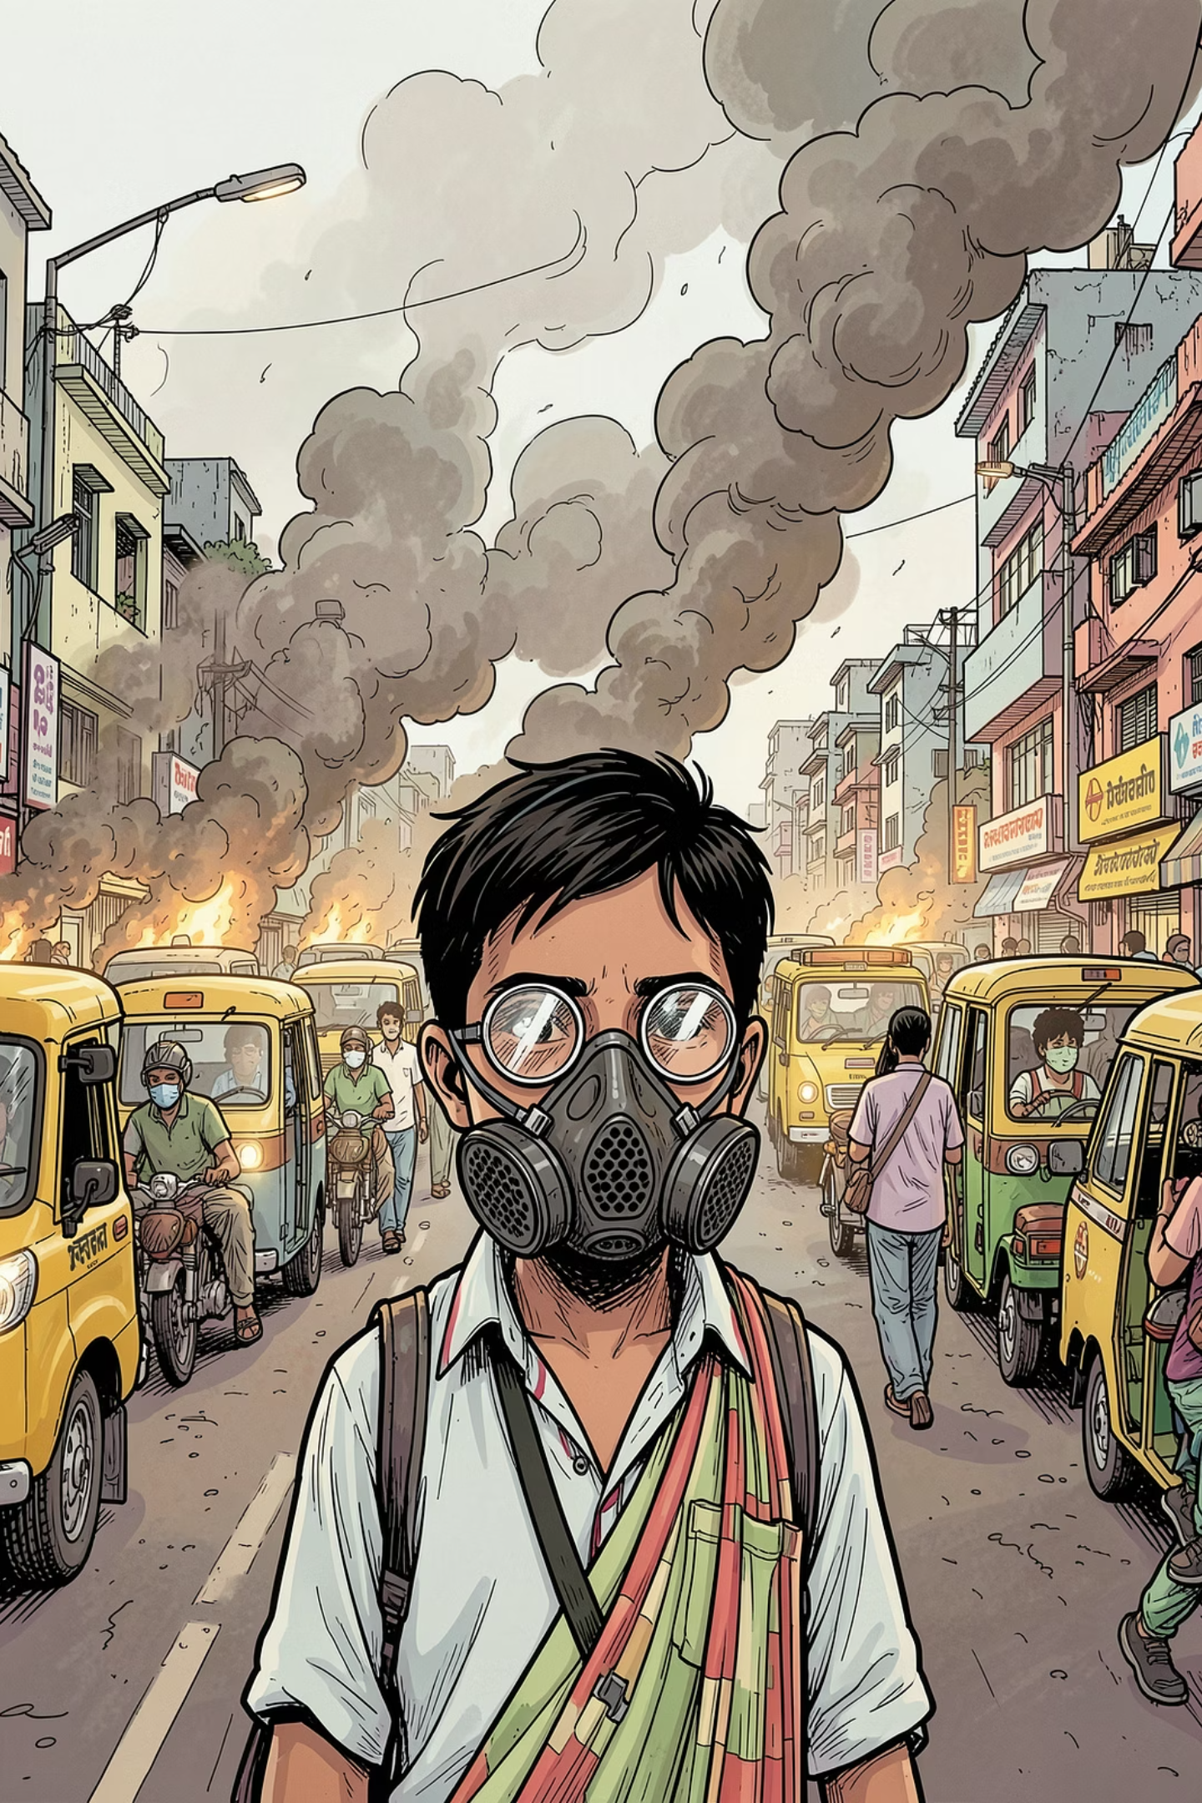

Why Air Quality Matters
21 of 30 Most Polluted Cities
India is home to 21 of the world's 30 most polluted cities — a public health emergency at national scale.
4.5× Above WHO Safe Limit
The WHO safe PM2.5 limit is 15 µg/m³. India's national average stands at 68 µg/m³ — 4.5 times higher.
70.7% of Days Are Unsafe
Over 70.7% of all recorded days exceed the WHO safe limit — the air is unsafe to breathe.
70.7% of days are unsafe to breathe — across 14 years and 241 cities, the vast majority of recorded days exceeded WHO safe PM2.5 limits.

Slide 4
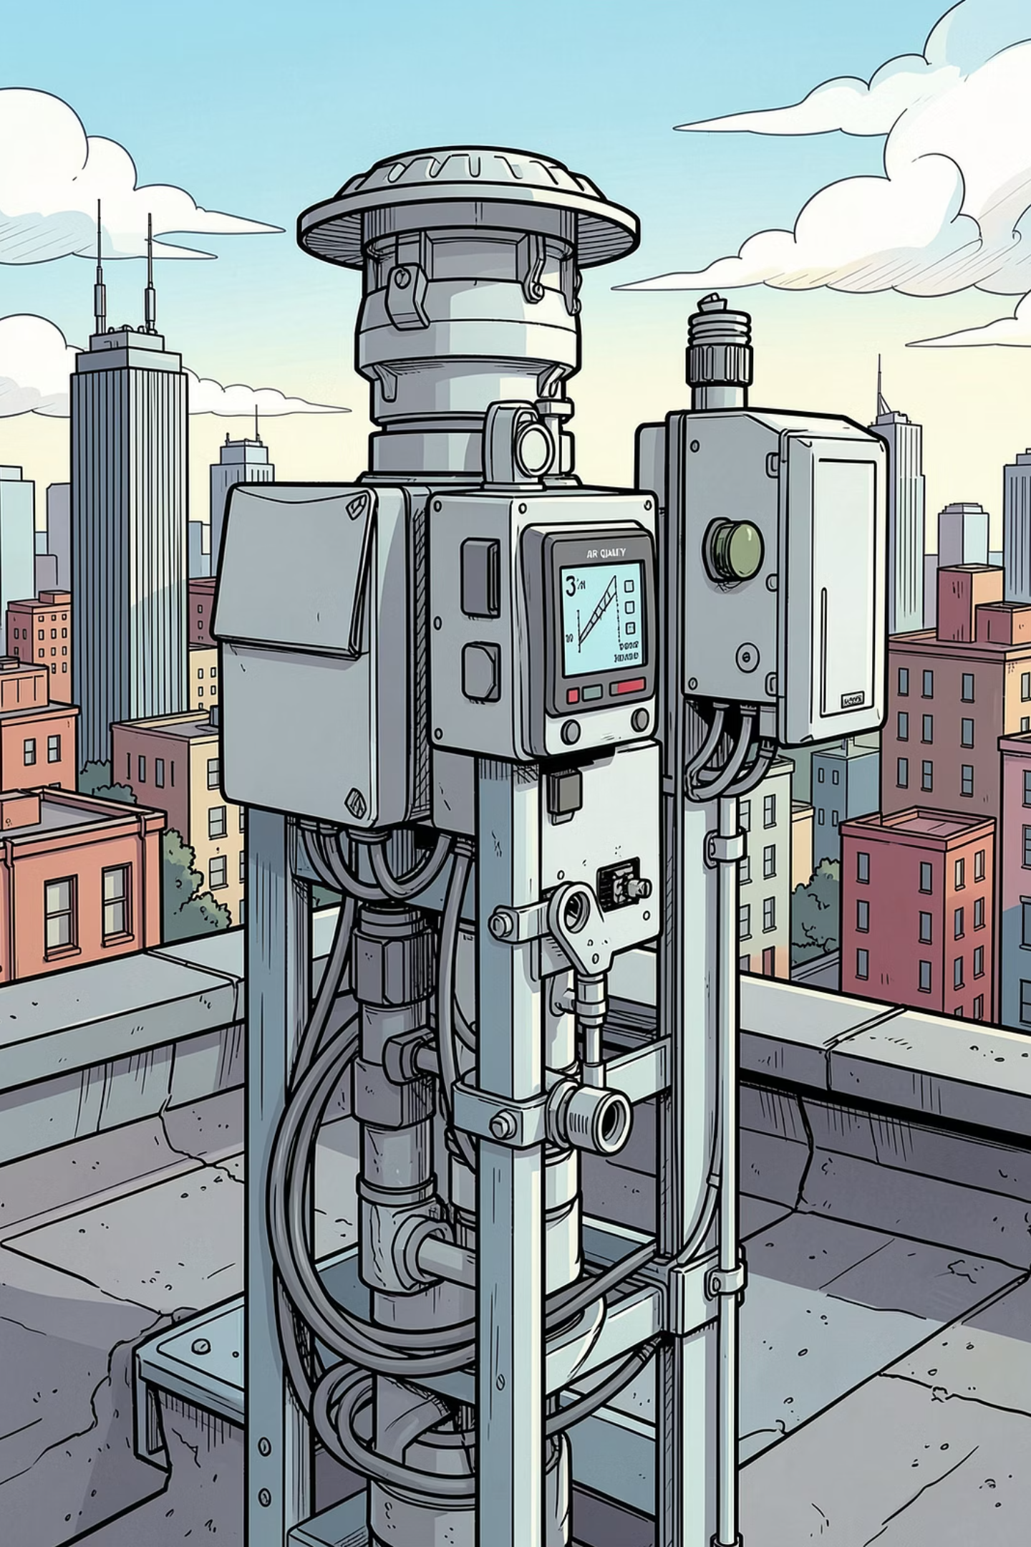
Dashboard at a Glance
68.0
National Avg PM2.5
µg/m³ — 4.5× the WHO safe limit of 15 µg/m³
229.2
Most Polluted City
Byrnihat — Severe category, nearly 15× the WHO limit
110.1
Worst State
Delhi — Highest state-level average across all 14 years
70.7%
Days Exceeding WHO Limit
Of all recorded days across the full dataset

Slide 5
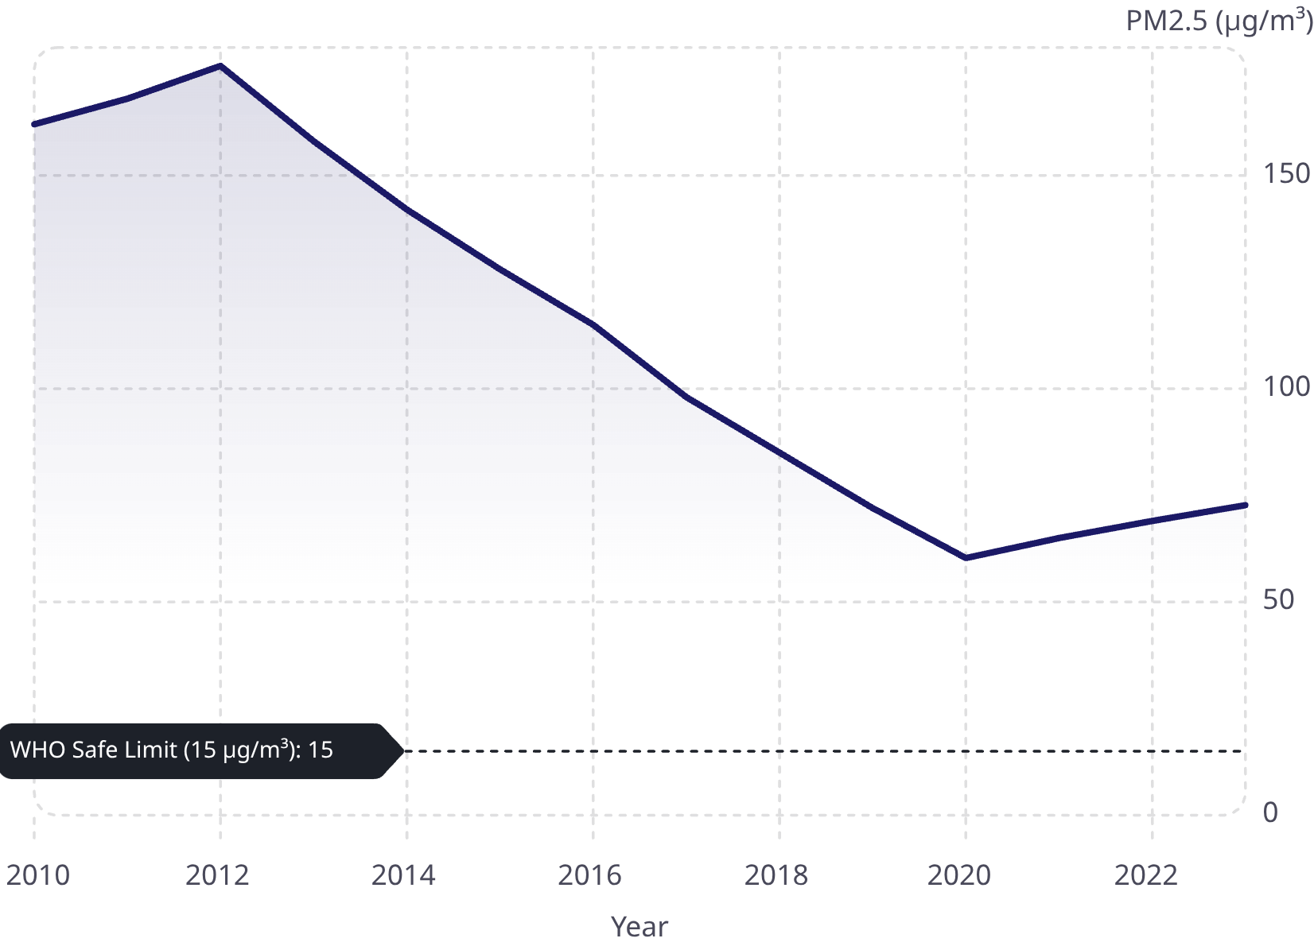

14 Years of Pollution — A Story of Slow Progress
Key Inflection Points
2012: Peak pollution year — 175.7 µg/m³, nearly 12× the WHO safe limit
2020: COVID lockdown — historic 16% drop to 60.3 µg/m³, the lowest in 14 years
2023: Post-lockdown rebound — 72.7 µg/m³, still 4.8× above WHO guidelines
The COVID lockdown in 2020 caused the single largest drop in air pollution in recorded Indian history — proving human activity is the primary driver.

Slide 6
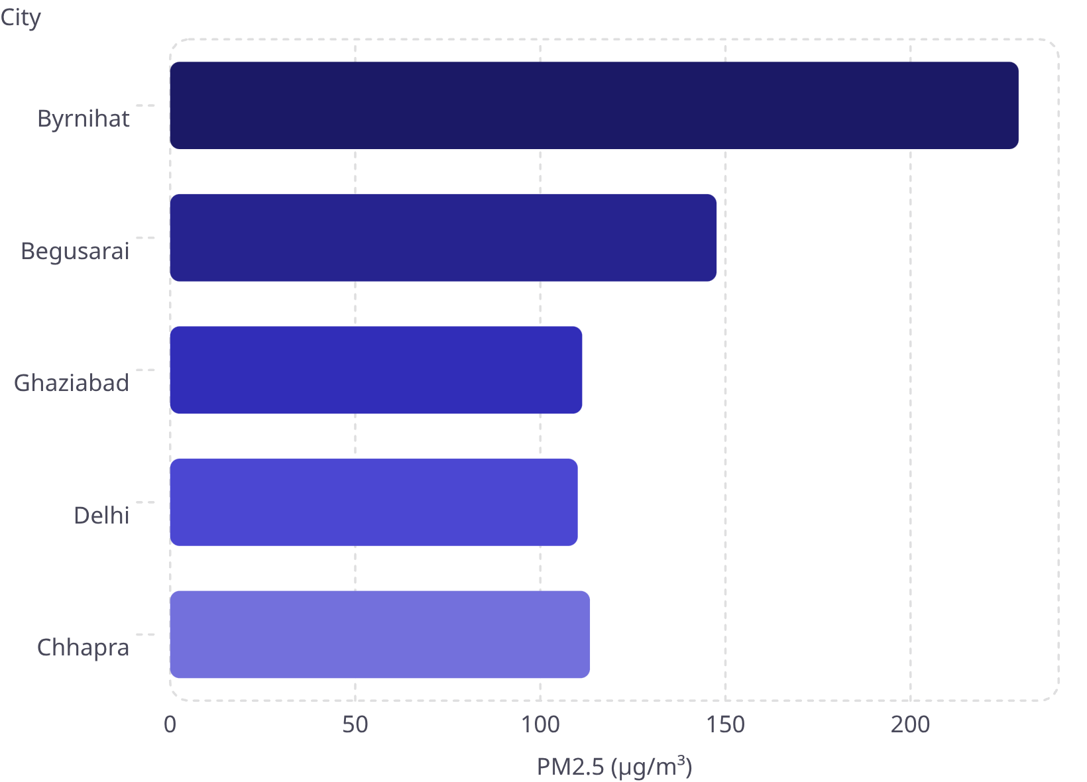
The Most Polluted Cities in India
Key Insight
Bihar dominates the top 10 — 6 out of 10 most polluted cities are in Bihar, not Delhi. Byrnihat's PM2.5 of 229.2 µg/m³ is over 15× the WHO safe limit.
Byrnihat — 229.2 µg/m³ (Severe)
Begusarai — 147.6 µg/m³ (Severe)
Chhapra — 113.4 µg/m³ (High)
Ghaziabad — 111.3 µg/m³ (High)
Delhi — 110.1 µg/m³ (High)

Slide 7

Geography of Pollution — State by State
Top 5 Most Polluted States
Bottom 5 Cleanest States
State
PM2.5 (µg/m³)
State
PM2.5 (µg/m³)
Delhi
110.1
Mizoram
11.75
Bihar
92.7
Sikkim
19.69
Uttar Pradesh
85.8
Arunachal Pradesh
20.4
Haryana
76.3
Meghalaya
21.9
Assam
69.2
Puducherry
23.6
North India is 9× more polluted than Northeast India. Delhi, Bihar, and Uttar Pradesh consistently top pollution charts across all 14 years — a regional crisis demanding targeted intervention.

Slide 8
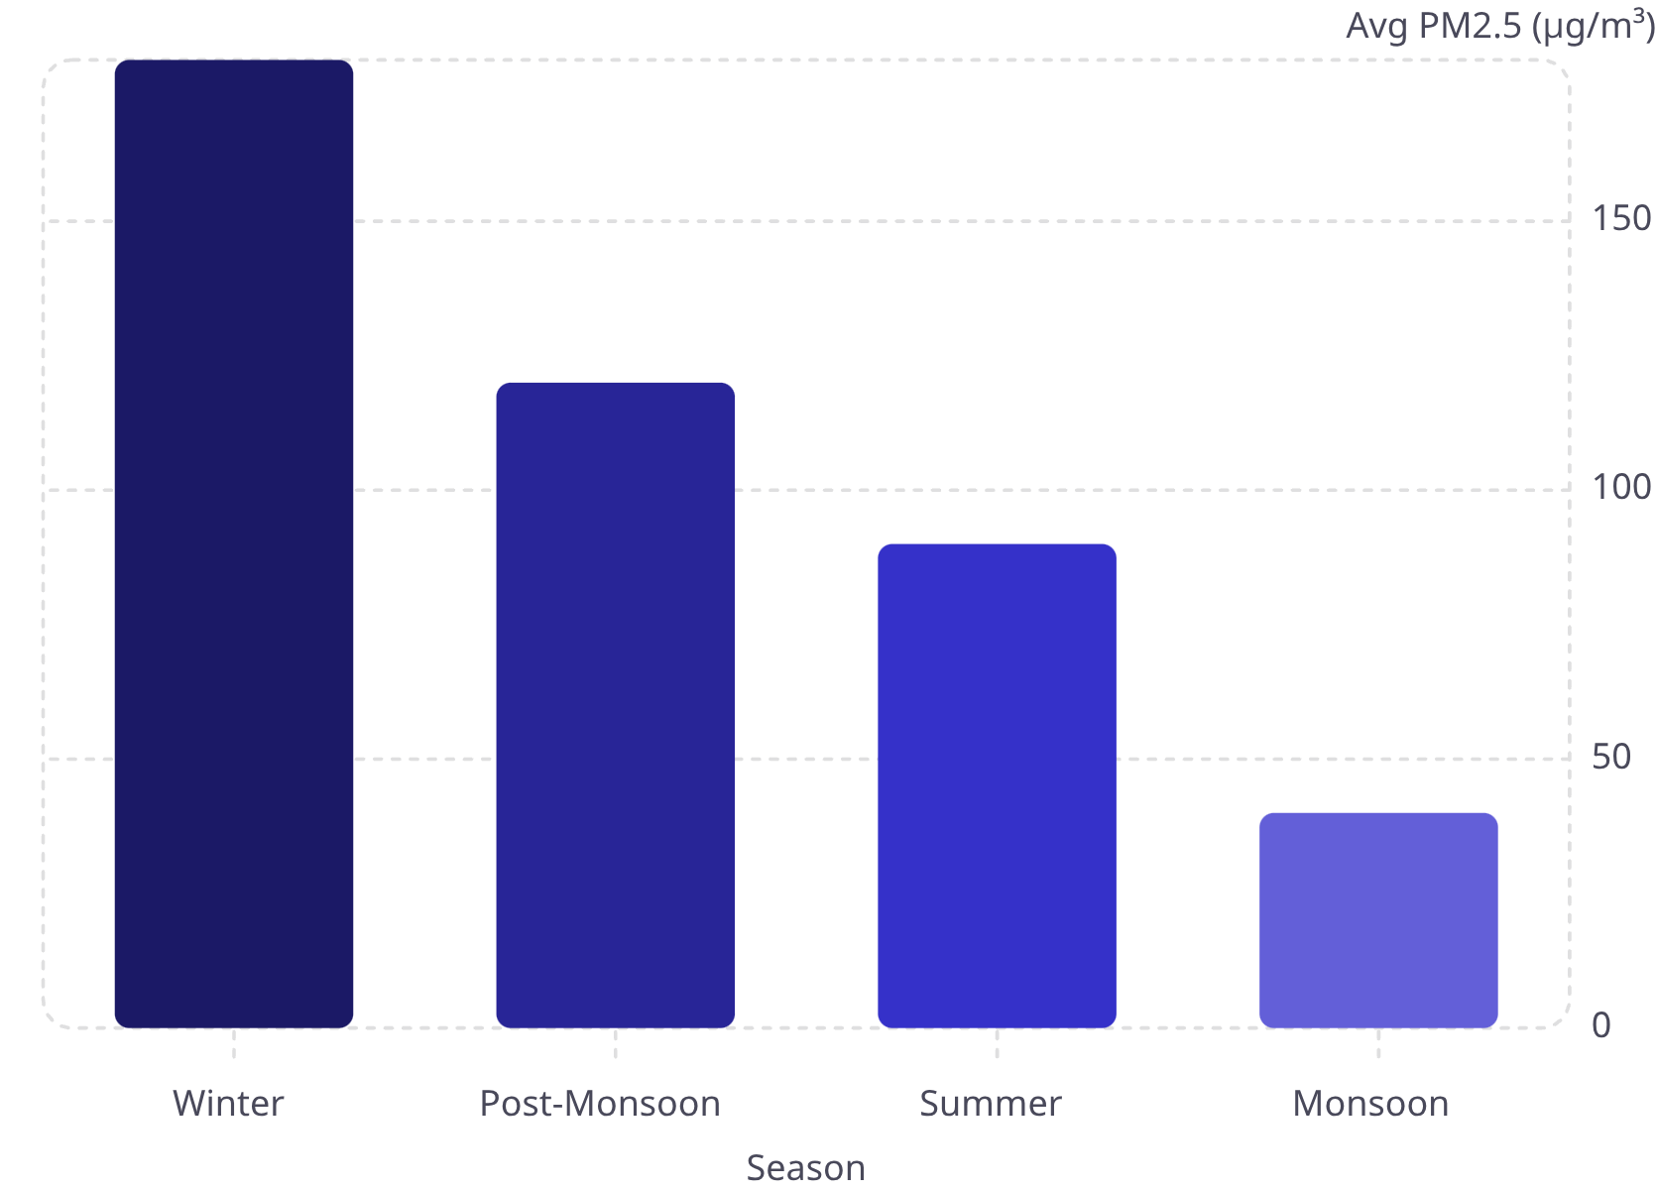
Winter is the Deadliest Season
Seasonal Breakdown
Winter (Dec–Feb) — SEVERE
Post-Monsoon (Oct–Nov) — HIGH
180+ µg/m³ — Crop burning and cold air trapping drive the worst pollution
120+ µg/m³ — Stubble burning across Punjab and Haryana spikes levels
Summer (Mar–May) — MODERATE
Monsoon (Jun–Sep) — LOW
40+ µg/m³ — Rainfall washes particulates from the atmosphere
90+ µg/m³ — Higher temperatures and winds provide partial relief

Slide 9
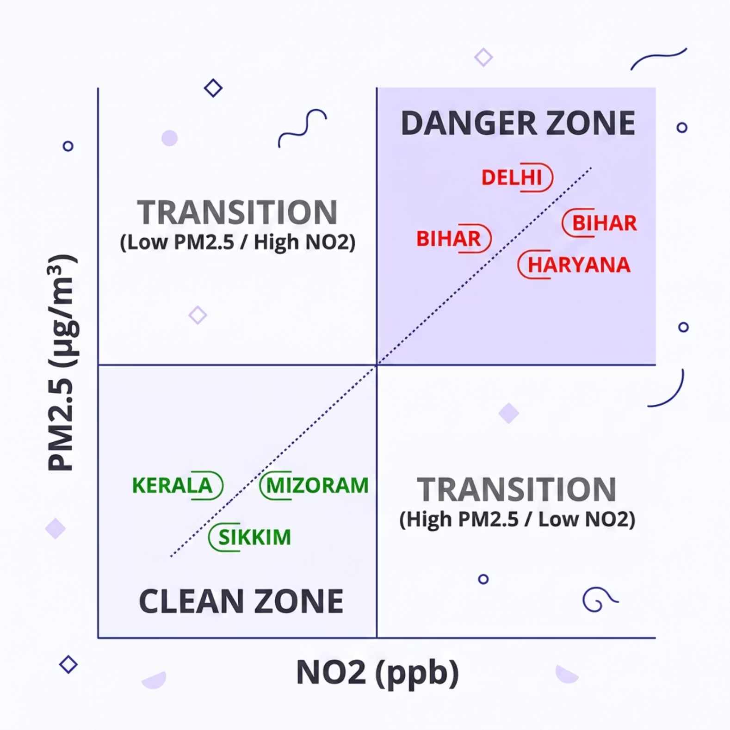

PM2.5 and NO2 — Two Sides of the Same Problem
What the Data Confirms
States with high PM2.5 consistently show high NO2 — confirming that vehicle emissions and industrial activity drive both pollutants in tandem.
Danger Zone: Delhi, Bihar, Haryana — extreme on both measures
Clean Zone: Kerala, Mizoram, Sikkim — low on both measures
Delhi sits in the extreme danger zone on both PM2.5 and NO2 — the most critical intervention target in India.

Slide 10
Key Takeaways and the Road Ahead
1
2
3
The Crisis Is Real
Change Is Proven Possible
North India Needs Urgent Action
India's air is 4.5× worse than WHO limits. Over 70.7% of days are unsafe to breathe.
The 2020 COVID lockdown delivered a 16% pollution drop — the largest in 14 years, proving human activity is the primary driver.
Delhi, Bihar, and UP top pollution charts across all 14 years — demanding targeted, sustained intervention.
Stricter Emission Standards
Crop Burning Ban
Expand AQI Monitoring
Enforce tighter vehicle norms in North Indian states
Year-round ban with farmer compensation and alternatives
Real-time monitoring in Tier 2 and Tier 3 cities
Data Source: India Air Quality Master Dataset · Analyzed with Tableau · 595,882 observations · 2010–2023

